Slide 1


Listen and repeat

Slide 2

MUMMY

Slide 3
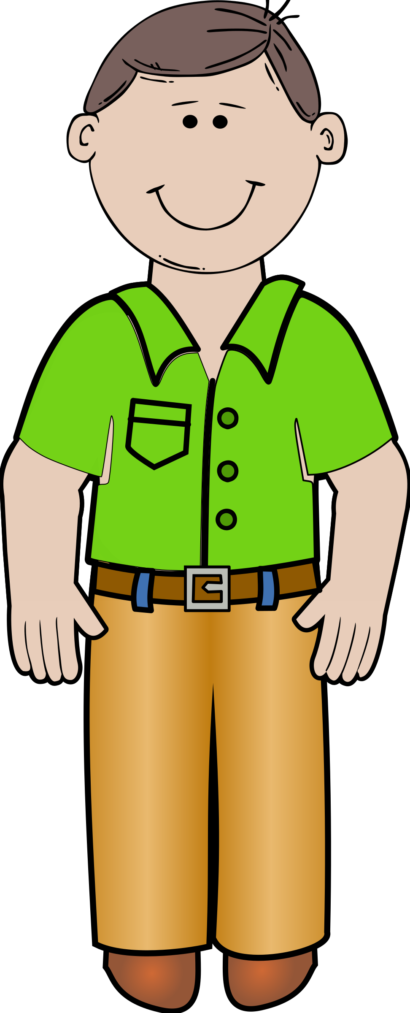
DADDY

Slide 4
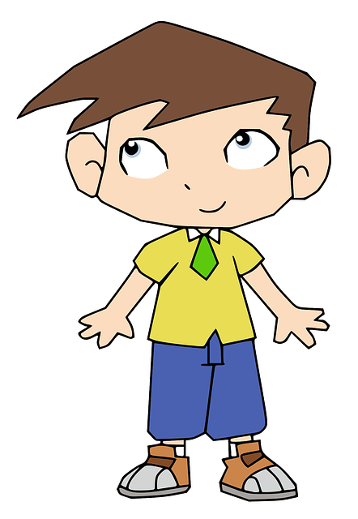
BOY

Slide 5
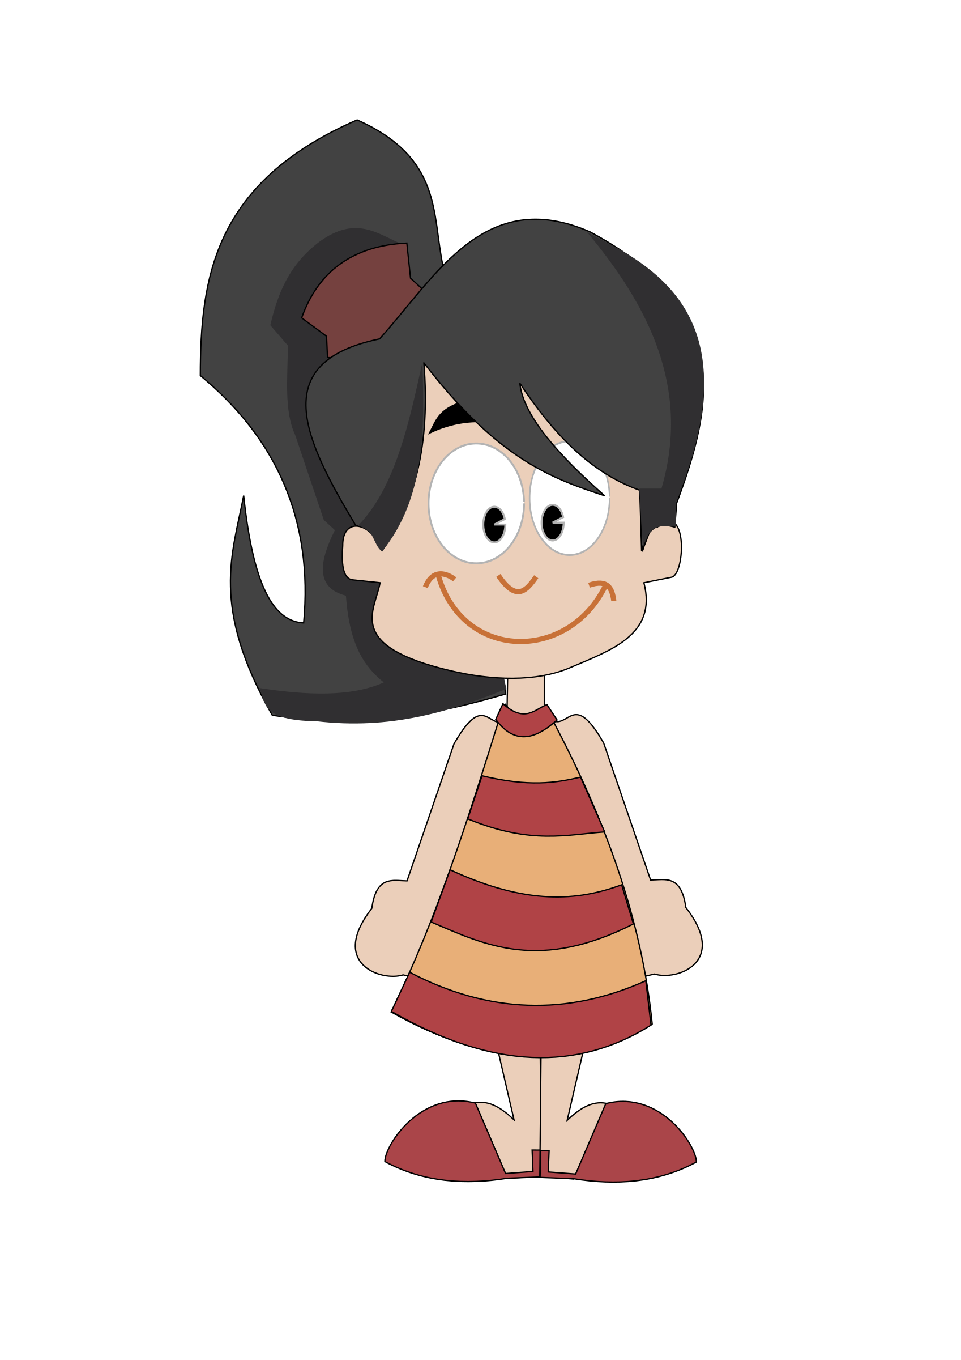
GIRL

Slide 6
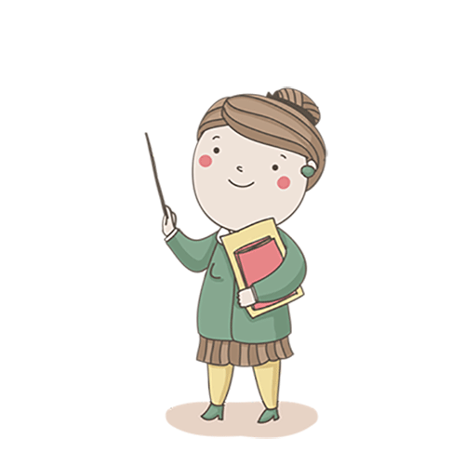
TEACHER

